Slide 1

SPA to PWA
Single Page Application hasta Progressive Web Application

Slide 2



Slide 3
Agenda
HORARIO | ACTIVIDAD
10:00 a 10:20 | Introducción
10:20 a 10:30 | Single Page Application (SPA)
11:40 a 12:00 | Break
12:00 a 12:10 | Static Web Apps
13:00 a 14:00 | Comida
14:00 a 15:30 | Static Web Apps
15:30 a 16:30 | Progressive Web apps
16:30 a 17:30 | Conclusiones y cierre

Slide 4


Azure Static Web Apps
SPA
SINGLE
PAGE
APPLICATION
{ }
Notes:
Etapas de una MPA
First Request
Response of full html
Second Request
Response of a new full html
SPA
First Request
Response of full html
Second Request
Only objects are send

Slide 5


Azure Static Web Apps
SPA
VS
MPA
Notes:
SPA Benefits
Quick experience with smart loading
Load data & views on demand
Provide native-like experience in the browser
Performance and User Experience
SPA Challenges
SEO Considerations
Browser History and evolution of browsers– pushState, replaceState
Requires JavaScript Enabled
Potential Memory leaks – must deal carefully with JavaScript

Slide 6
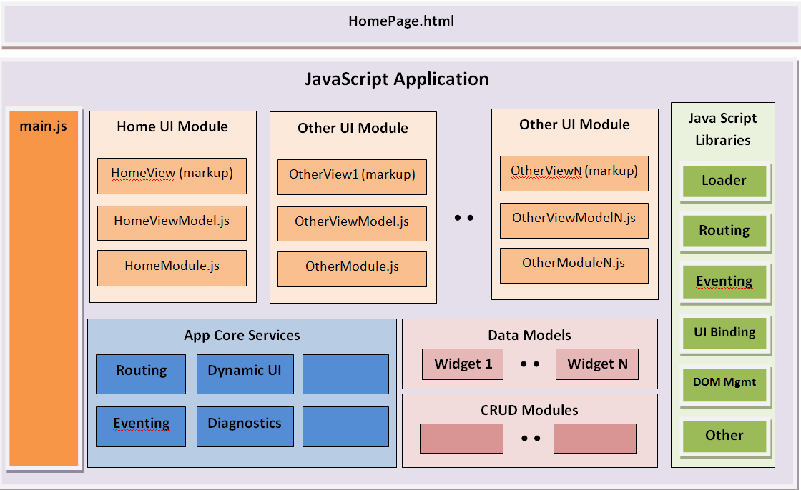
Azure Static Web Apps
Notes:
Etapas de una MPA
First Request
Response of full html
Second Request
Response of a new full html
SPA
First Request
Response of full html
Second Request
Only objects are send

Slide 7
Azure Static Web Apps
SPA
SWA
SINGLE
STATIC
PAGE
WEB
APPLICATION
APPLICATIONS
Notes:
Etapas de una MPA
First Request
Response of full html
Second Request
Response of a new full html
SPA
First Request
Response of full html
Second Request
Only objects are send

Slide 8
Azure Static Web Apps
build and host static web apps
Notes:
It’s a new Azure Service for building and hosting static web applications,

Slide 9

Notes:
Angular, React, Svelte And Vue. Blazor
These tools have fundamentally changed the way we build web applications. Instead of a server runtime that makes database queries and builds pages dynamically when they are requested, these new JavaScript powered applications run entirely in the browser. We have moved the application responsibilities of the server, entirely into the client.

Slide 10
authentication and authorization
build and host static web apps
authentication and authorization
Notes:
You get authentication and authorization

Slide 11
APIs powered by Azure Functions
build and host static web apps
authentication and authorization
APIs powered by Azure Functions
Notes:
And it features API’s powered by Azure Functions

Slide 12


CI/CD powered by GitHub Actions
build and host static web apps
authentication and authorization
REPO
APIs powered by Azure Functions
app
api
CI/CD
Notes:
and a CI/CD pipeline powered by GitHub Actions that's automatically setup for you.

Slide 13







So how does this work?
STATIC WEB APPS
REPO
STATIC CONTENT
HTML/JavaScript/CSS
app
PUSH/PR
ACTION
api
API
Azure Functions
Notes:
So how does this work?
You create an Angular, React, Vue, Svelte Static Site generator or even just an index.html page.
If you want an API, you create an “api” folder in your project and add in some Azure Functions endpoints.
You push your code to GitHub, and Azure Static Web Apps creates the GitHub Action to build your project and then deploys it a geo-replicates it to 5 regions immediately.

Slide 14
SPA
SWA
PWA
SINGLE
STATIC
PROGRESSIVE
PAGE
WEB
WEB
APPLICATION
APPLICATIONS
APPLICATIONS

Slide 15
Aplicación Web en forma nativa Acceso de Recursos locales y versatilidad de
aplicación web
Notes:
Integración de lo mejor de dos mundos. Web app en su core pero con acceso a Recursos locales como son:
Install on Home
Offline
Push notification
Acceso a recuses locales
Background Sync
Ubicación

Slide 16



Similar a
app
Independiente de la
conectividad
Progresivo
Notes:
Integración de lo mejor de dos mundos. Web app en su core pero con acceso a Recursos locales como son:
Install on Home
Offline
Push notification
Acceso a recuses locales
Background Sync
Ubicación

Slide 17


Similar a
app
Independiente de la
conectividad
Progresivo
Notes:
Integración de lo mejor de dos mundos. Web app en su core pero con acceso a Recursos locales como son:
Install on Home
Offline
Push notification
Acceso a recuses locales
Background Sync
Ubicación

Slide 18

Similar a
app
Independiente de la
conectividad
Progresivo
Notes:
Integración de lo mejor de dos mundos. Web app en su core pero con acceso a Recursos locales como son:
Install on Home
Offline
Push notification
Acceso a recuses locales
Background Sync
Ubicación

Slide 19
Elementos Mínimos
HTTPS*
Web App Manifest
Service Worker
*HTTPS not required when using localhost domain

Slide 20
Elementos Mínimos
HTTPS*
Web App Manifest
Service Worker
*HTTPS not required when using localhost domain
Notes:
Web App Manifest de una pagina tiene la informacion
Que necesita Progressive Web App para controlar como se ve y como se comporta
Cuando es instalada.
Son un tipo de web workers especiales con
La habilidad de interceptor
Modificar y responder
A todos los request online o offline
Usando el fetch api.

Slide 21
Elementos Mínimos
HTTPS*
Web App Manifest
Service Worker
*HTTPS not required when using localhost domain
Notes:
Son un tipo de web workers especiales con
La habilidad de interceptor
Modificar y responder
A todos los request online o offline
Usando el fetch api.

Slide 22
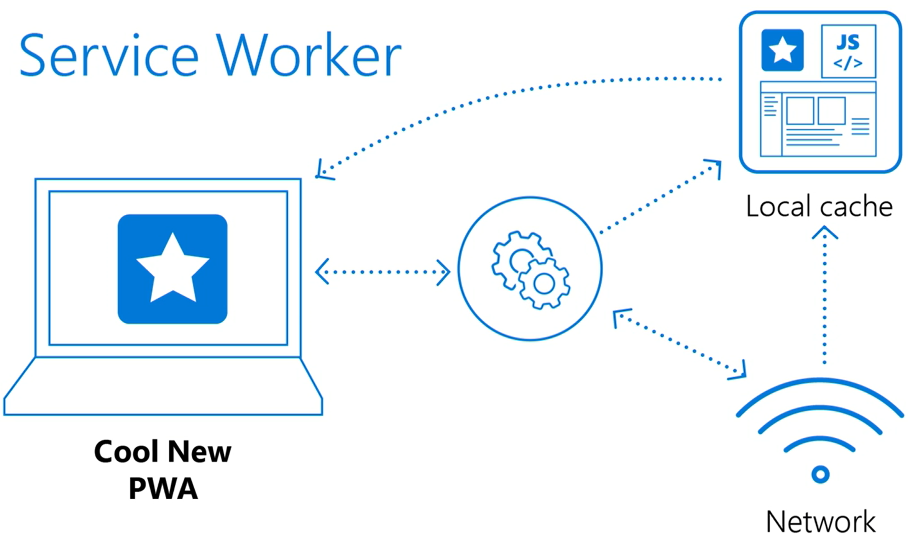
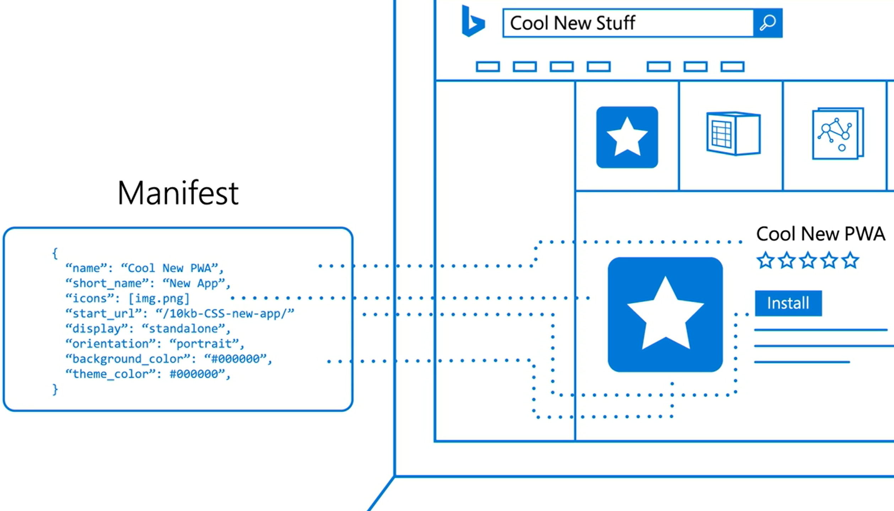

Slide 23


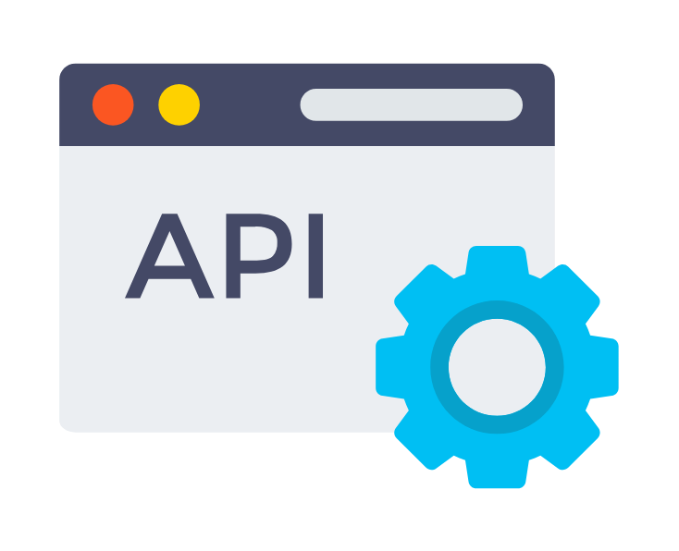
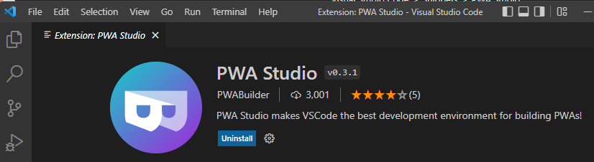
Microsoft en PWA
PWA Builder
PWA Studio
Windows API
Notes:
No olvidar los elementos da cambio de target en VS
API: Windows ML y AI Gallery

Slide 24
QUESTIONS??
THANK YOU

Slide 25
MicrosoftDocs/mslearn-staticwebapp: Static Web App template repository (github.com)

